Slide 1
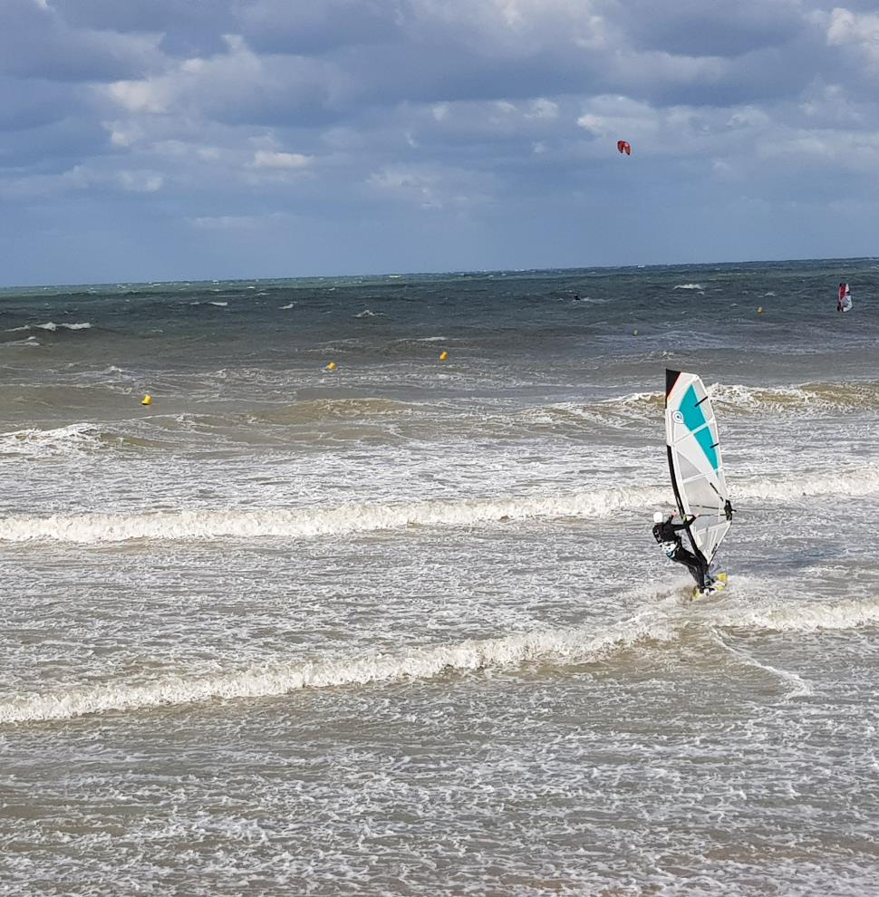
Continuous Architecture
Work In Progress
Method

Slide 2
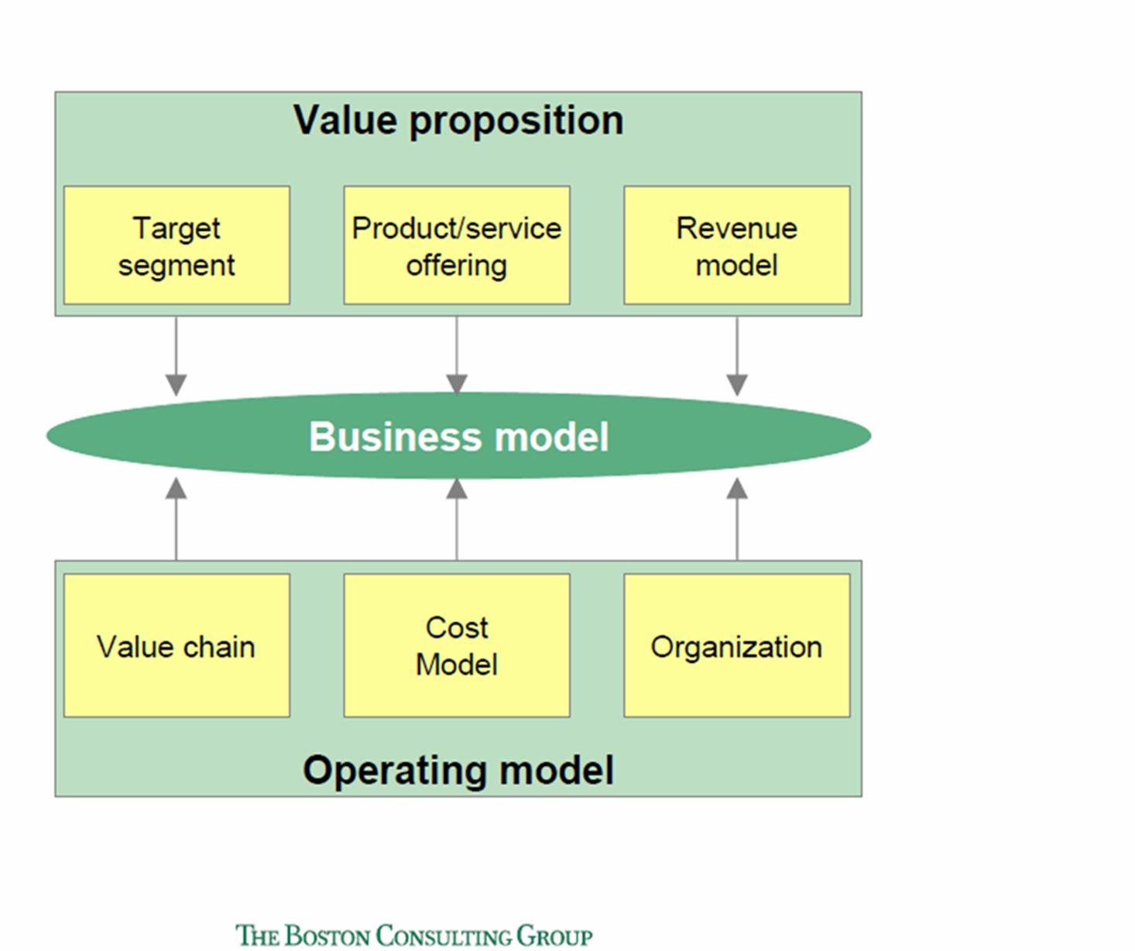
Building Blocks to shape your Business Model
Agile Strategy
BUSINESS MODEL
Experience
Product
Revenue Model
Software
Profit Formula
Platform
Operations
Organization
Cost, investment & risk Model

Slide 3
Generic approach to be customized at 3 levels
Agile Strategy
Business Unit
Feedback
Inverse Conway Maneuver
Value Area
Concurrent Engineering
Product Family
Product
Agile
Organization
Experience
Operations
Platform Architecture
Roadmap
Software
Optional Pilot
Learning cycle

Slide 4
Waterfall is not fit for purpose in a digital world
Strategy & Business Model
cascading
iteration
Target Operating Model
IT Architecture

Slide 5
Digital and Agile 3 Architecture levels
Enterprise
Architecture
iteration
Iterative
Value Area
Architecture
Product Family Architecture

Slide 6
Waterfall and siloed approach
Strategy & Business Model
Target Operating Model
BU Strategy
Value proposition
Target segments
Brand
IT Architecture
Organization design
Process
Target setting
Value Chains
Core business
Revenue Model
Governance
Cost Model
Performance management
Road map
IT infrastructure
Digital capabilities
Roles & Responsibilities
Share services
Risk management
Sourcing
IT Software
DATA
Change management
Portfolio management
Location

Slide 7
Systemic & iterative approach
Enterprise
Architecture
Agile Strategy
Roadmap
Value Area
Architecture
Experience
Product
Product Family
Architecture
Organization
Operations
Platform
Software

Slide 8
Business Unit Level
Agile Strategy
Experience
Product
Operations
Software
Platform
Organization
Roadmap
Top-Level OKRs
Customer Experience Vision
Product/Market Segmentation
Required Capabilities
Candidate IT Platforms
Platform Strategy
Organization Design
Major
Milestones
Value Streams
Platform Standards
Leadership model
Experience Segmentation
Product Families Identification
Smart Offering enablement
Candidate
Operations Platforms
Revenue Model
Intelligent Automation Enablement
Platform Governance
Governance
model
Value Areas Definition
Candidate
Product Platforms
Sourcing
Analytics
Enablement
Location
Cost, Investment, Risk Model
Data Architecture Blueprint
Security Requirements

Slide 9
Value Area Level
Agile Strategy
Experience
Product
Operations
Software
Platform*
Organization
Roadmap
Value Area Vision
Jobs To Be Done (level 3)
Product Families Definition
Journey Maps
Sample
Non-Functional Requirements
Required IT Platforms
Agile Teams Topology
Integration Events Identification
Jobs Maps
(level 3)
Differentiating
Features
Value Streams Definition
Trade-Offs Analysis
IT Platforms Run Cost
Management Practices
Economic Model Adjustment
Integration Events
Experience Maps
Sample
Guardrails and Fitness Functions
Job Story Clusters
Digitization Strategy
Product & Operations Platforms Feasibility**
Change Management Strategy
Roadmap Adjustments
Objectives and Key Results (OKR)
User Stories
Sample
Commonality
Analysis
Sourcing Strategy
Patterns and Standards
Big Picture Event Storming and Strategic DDD
Data Architecture Patterns and Data Product Feasibility
* Platforms are managed as products
Architecture Decision Records (ADR)
** Required and supplied
Security Architecture

Slide 10
Product Family Level
Agile Strategy
Experience
Product*
Operations
Software
Platform*
Organization
Roadmap
Jobs To Be Done
Product
Scoping 360°
Journey Mapping
Architecture
Runway
IT Platforms Consumption Model
Deployed OKRs
Prioritized
Jobs To Be Done
Backlog
Product Family Vision
R
Value Stream Mapping
Jobs Maps
Architecture
Kata
Team Autonomy Readiness
Product
Features
R
Product Portfolio Definition
Product & Operations Platforms Integration
R
Prioritized
Feature backlog
Value Stream improvement / (Re)Design
R
Experience Maps
Peer Review
R
Product User Stories
New Ways of Working
R
Dependency Management
Operability Review
User Stories
Product Business Case
Smart Process Automation
R
Security Review
Individual Change Management
Prioritized
User Stories backlog
Event Storming and Tactical DDD
Data Architecture
* Feasible Platforms and Data Products are created by Lean Product & Process Development
Architecture Decision Records (ADR)

Slide 11
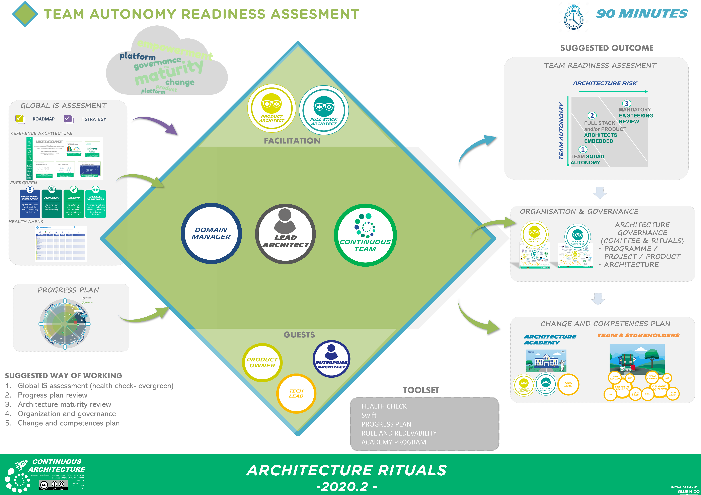
Ritual example

Slide 12
Business Unit Transformation Change Skills Organization
Strategic League
Experience League
Operating League
Agile Strategy
Experience
Operations
Roadmap
Change skills
for each building block
or sub block
=
cross league skills
Product
Platform
Organization
Software League
Software
Data League
Data Architecture Blueprint
Security League
Security Requirements
Cost & Revenue League
Revenue Model
Cost Model

Slide 13
Business Unit Transformation Transformation Teams Staffing
Staffing
Transformation teams
Enterprise
Architecture
Change skills
Run
Value Area
Architecture
Change Skills
Run
skills
Product Family Architecture
Change
Skills
Run Skills

Slide 14
Business Unit Transformation Governance
Steering committee
Synchronization
meetings
Objects managed
Enterprise
Architecture
Business Board
Every 4 months
Strategic Review
Every 4 months
OKR,
Culture
New business
….
iteration
Iterative
Examples
Examples
Value Area
Architecture
Value Area Board
Every 2 months
Business Review
Release
Emblematic KPIs
Management practices
Investments,
….
Product Family Architecture
Product Board
Monthly
Product Review
Sprint
Teams Backlogs
Ways of working
Weak signals
…

